Slide 1

Scrum
Training
https://scrumguides.org/scrum-guide.html

Slide 2

Scrum Theory
Scrum Training - 2022
Scrum employs an iterative, incremental approach to optimize predictability and to control risk. Scrum engages groups of people who collectively have all the skills and expertise to do the work and share or acquire such skills as needed.
Transparency, inspection, and adaptation.

Slide 3

Suite Roles
Scrum Training - 2022
Product:
Does the product fit the market and our clients needs?
UX:
Are the screens and workflows easy to use?
Engineering:
Does the product work as it is designed?

Slide 4
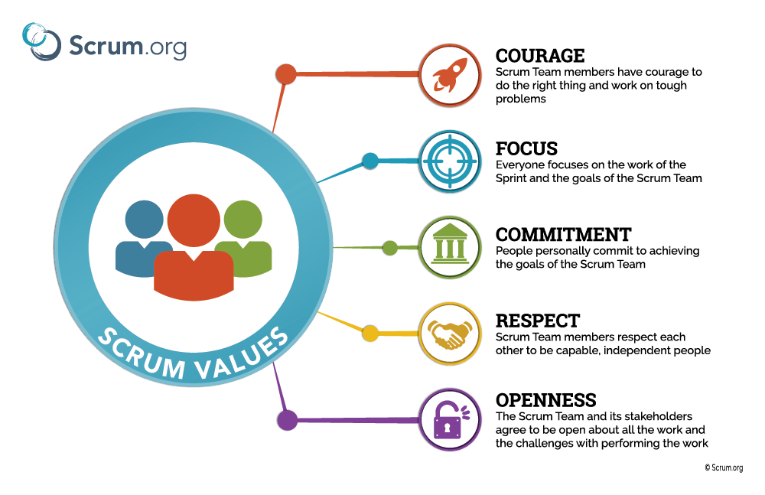
Scrum
Values
Scrum Training - 2022

Slide 5
Scrum Events
2022 Scrum Training
https://scrumguides.org/scrum-guide.html

Slide 6
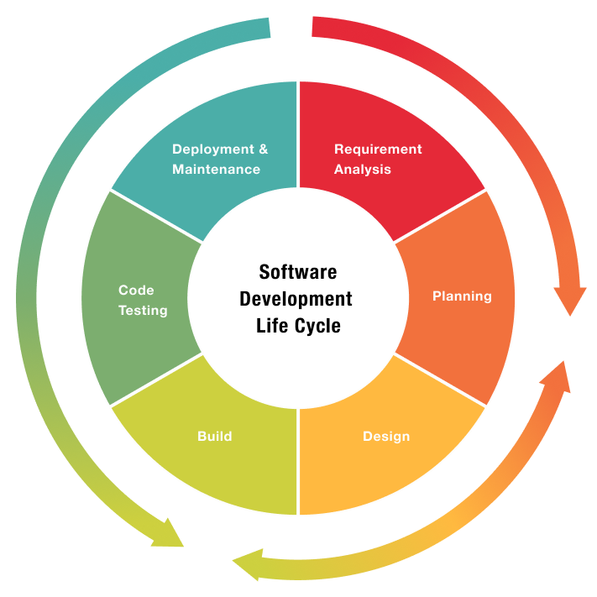
SDLC
Scrum Training - 2022
Engineering
Product
Collaboration Prod., UX, Eng.

Slide 7
Scrum Events
Scrum Training - 2022
Sprint Preparation
Refinement*
Technical Design*
The Sprint
Sprint Planning
Daily Scrum
Sprint Review
Sprint Retrospective
The Sprint is a container for all other events. Each event in Scrum is a formal opportunity to inspect and adapt Scrum artifacts. These events are specifically designed to enable the transparency required. Failure to operate any events as prescribed results in lost opportunities to inspect and adapt. Events are used in Scrum to create regularity and to minimize the need for meetings not defined in Scrum. Optimally, all events are held at the same time and place to reduce complexity.
*Backlog Refinement and Technical Design are not official Scrum Events because each organization will have strategically different needs in how they should be implemented. They are, however, recommended Scrum practices that should be seen as essential to get work ready for a Sprint.

Slide 8
Meeting D.o.r.
Scrum Training - 2022

Slide 9
Refinement tips
Scrum Training - 2022
Refinement time is used to break down epics into features and stories and ensure those stories have all the information the engineering team needs to complete it within a sprint. This is often called meeting the Definition of Ready (DOR)
Definition of ready is determined by each team. It defines what is needed before a story can come into the sprint. There is a temptation to be overly prescriptive and heavy handed on what DOR could mean. However, a story should be sized correctly and have acceptance criteria.
Refinement will never be perfect. Items that come up after a story has been started are blockers or issues.
Don’t forget about dependencies.

Slide 10
Technical design tips
Scrum Training - 2022
Engineers can drive these, but it is ultimately the engineering leadership that should ensure good design is being implemented.
Use Architects for good patterns and design. They will show how to create libraries, but implementation will ultimately be the responsibility of the engineering team. Architects should not be part of the critical path. Architects can be excused from the meeting if they are not needed.
If US based resources are not needed, this can happen anytime.
Product may not be needed. Their role is to consult on whether the design still meets the product vision.
Intended for projects, big or small

Slide 11
Meeting D.o.D and Sprint Goals
Scrum Training - 2022

Slide 12
Sprint Review Tips
Scrum Training - 2022
Not just a demo. It should be a working session to determine the success of the sprint
Can do some UAT.

Slide 13
Sprint Retro tips
Scrum Training - 2022
Avoid Groupthink. Find a way to submit ideas individually. Then collaborate.
Blame free!
Don’t forget to call out what went well.
Praise teammates.
Prioritize issues and make assignments on action items.

Slide 14
Sprint Planning Tips
Scrum Training - 2022
Velocity is not a measure of performance. It is a tool to predict the amount of work that can be completed in a sprint. It’s important, it should be visible and used by the team for insight into their work, but it should not be used to evaluate pay, bonuses or rewards.
If a story is not ready, punt it, or, if it has a high priority, refine it.
You can always pull more storying in to the sprint
Focus on moving closer to outcomes.
Large stories, typically those that are larger than a 5, should be split to smaller stories.

Slide 15
Keep the sprint Going
Scrum Training - 2022

Slide 16
The purpose of daily scrums
2022
Team comradery
Discuss the team’s progress on the sprint goals and make adjustments
Escalation of issues and blockers

Slide 17
Daily Scrum Tips
Scrum Training - 2022
Sometimes we call these standups. If you are standing during the entire meeting and are getting tired, the meeting is too long. Standing up discourages individuals from talking too long. (Standing up is not required but being brief is!)
Less than 15 minutes!
Focus on progress of projects
Focus on blocker and issue.
Maintain hire scrutiny on project at risk or are time sensitive
Setup time to take deeper discussions.
Product will not typically be in stand up. Try and communicate product blockers in slack and hopefully they will be resolved before you log on the next day

Slide 18
BLOCKERS: TECHNICAL VS DESIGN VS PRODUCT
Scrum Training - 2022
Engineering managers should have the responsibility to ensure technical blockers are resolved but anyone on the team can take the necessary steps.
Reach out to other teams or subject matter experts
Reach out to architects.
Product managers and UX should have the responsibility to ensure product or design blockers are resolved but anyone on the team can push for resolutions.
Many blockers can be resolved using slack
Create a team blocker channel (NOT private) #engineer-<team>-blockers. Add me, etc.
Be descriptive to reduce back and for, especially, when you want a resolution during your night time
Some can wait until stand up or refinement. If not, create an ad-hoc meeting in US morning time

Slide 19
The purpose of one on ones
Scrum Training - 2022
Comradery
Time to share sensitive information. Two way communication.
Issues with team or teammates
Performance coaching
Set and track goals or “Outcomes” of individuals
Career management
NOT as status meeting
I find 30 minutes to be plenty long. But take longer if you need to.

Slide 20
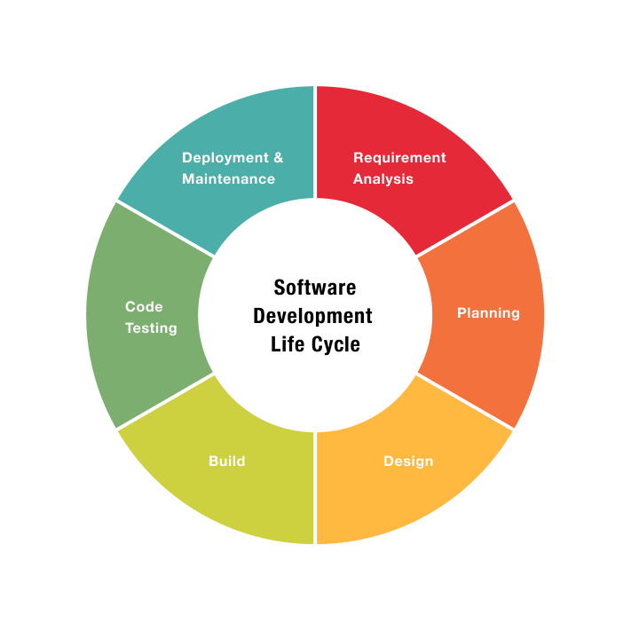
SDLC
Scrum Training - 2022
Definition of Done (DOD)
Definition of Ready (DOR)

Slide 21
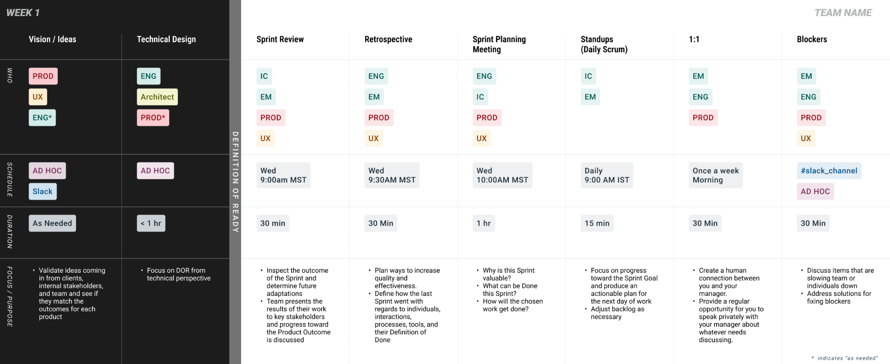
2022

Slide 22
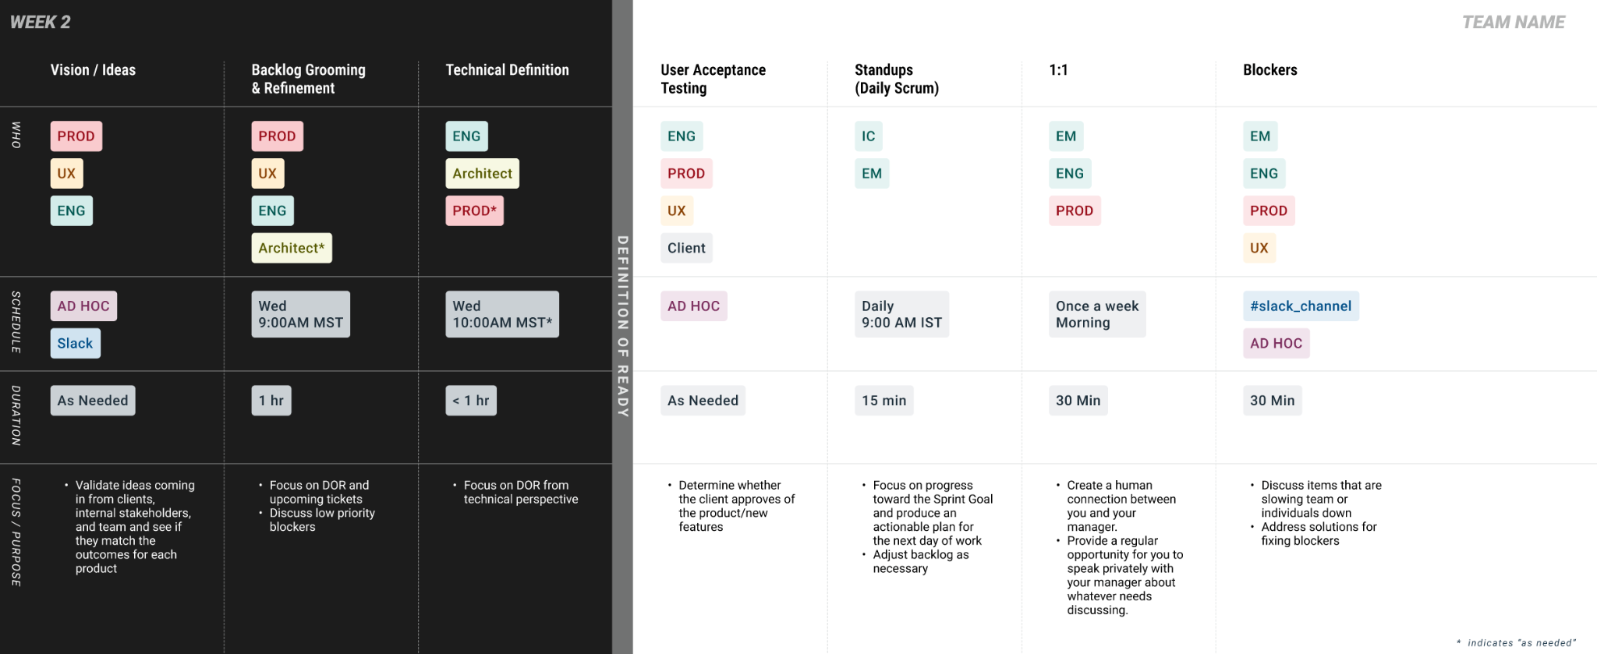
Scrum Training - 2022

Slide 23
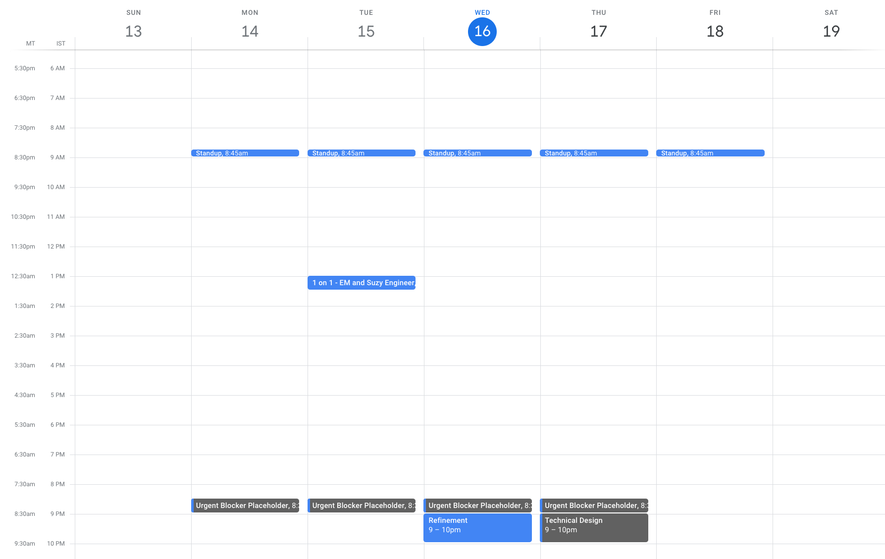
Scrum Training - 2022

Slide 24
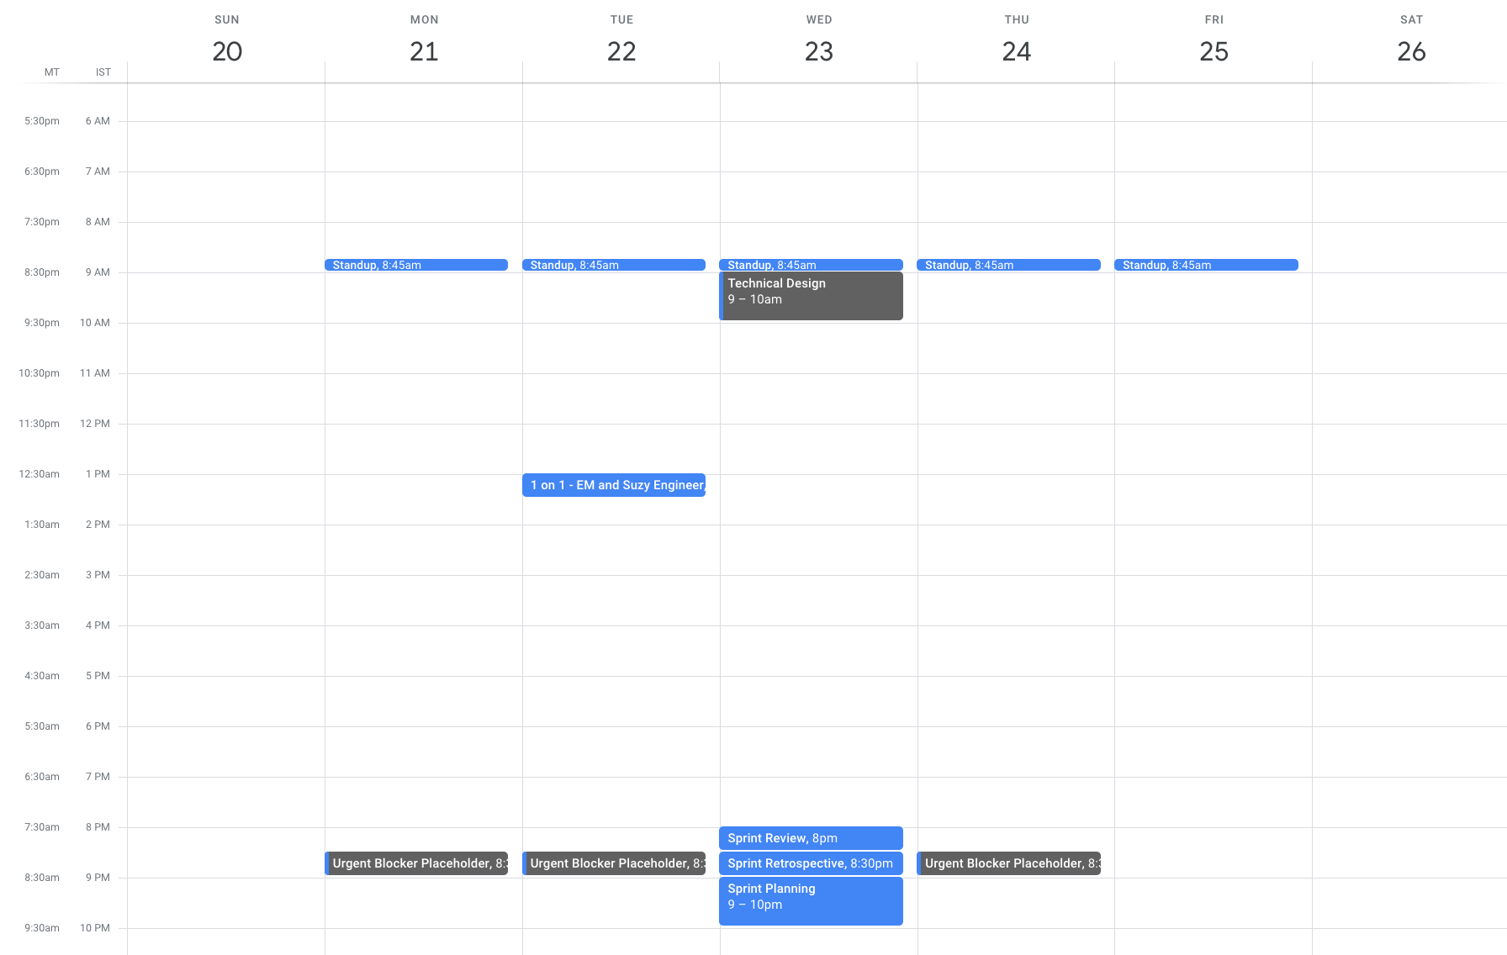
Scrum Training - 2022

Slide 25
How do we define success?
Scrum Training - 2022
How many ad-hoc or unplanned meetings are happening?
Is each sprint filled with DOR stories?
How much refinement is happening in SPM?
How long does it take blockers to be resolved?
How many blockers are there each week?
How engaged do engineers, designers and product owners feel?

Slide 26
We should be students of our craft
Continuously improve all areas of our jobs
https://scrumguides.org/scrum-guide.html

